Slide 1




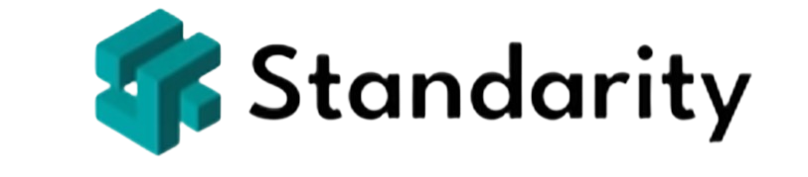
Apply Threat Modeling (Optional Advanced Step)
Use threat modeling for complex environments
Identify technical weaknesses and entry points
STRIDE helps classify threat types
CloudCore applied STRIDE to its APIs
Strengthened MFA and logging controls
Not required, but adds depth to DR
Map threats to system architecture
Supports secure recovery planning
Disaster Recovery Step by Step
Notes:
For organizations with complex systems—particularly those delivering digital products—threat modeling can provide deeper insight into how specific systems may be exploited.
Threat modeling focuses on identifying potential attacker goals, system weaknesses, and how those weaknesses could be used to compromise confidentiality, integrity, or availability.
One popular method is the STRIDE model, which categorizes threats as Spoofing, Tampering, Repudiation, Information disclosure, Denial of service, and Elevation of privilege. It helps teams analyze how users, systems, and data flow through an application—and where threats might emerge.
At CloudCore, the DR team applied STRIDE to their API authentication module.
They identified potential spoofing and tampering risks that could disable login services. This analysis informed the need for multi-factor authentication and audit logging.
While threat modeling is optional for basic DR planning, it’s highly recommended for cloud services, SaaS platforms, and regulated environments.
It allows for precise mapping of technical threats to recovery strategies.

Slide 2
Use the Risk Assessment Template
Download the Risk Assessment Template
List and rate each threat systematically
Track actions and review regularly
Assign controls and mitigation owners
Assign a risk level and describe any mitigation
Use CloudCore examples for guidance
Makes risk data easy to visualize
Supports planning, audits, and reporting
Disaster Recovery Step by Step
Notes:
To help organize your findings, use the Risk Assessment Template provided in this course.
This downloadable document allows you to systematically list threats, rate their risk, and track responses.
It includes columns for threat description, affected systems, likelihood, impact, current controls, proposed actions, and owner. Begin by transferring the risks identified during your workshops or interviews. Then assign values for likelihood and impact using your predefined rating system.
Assign a risk level (e.g., High, Medium, Low), and describe any mitigation already in place. Add action items for unresolved risks and assign them to team members with due dates.
The CloudCore example in the template shows risks like “Cloud provider failure” and “Malicious employee action,” each rated and assigned to owners for action. By walking through this document, you'll get a clear view of which risks require immediate attention and what can be managed over time.
This template helps you move from abstract analysis to concrete planning and allows for easy sharing with leadership, auditors, or external consultants.

Slide 3
Map Systems to Recovery Priorities
System | Tier | RTO | Strategy Type
SaaS Platform | 1 | 4 hours | Hot standby + failover
Customer Support Ticketing | 1 | 6 hours | Cloud replication
CI/CD Pipeline (DevOps Tools) | 2 | 24 hrs | Snapshot backup
HR Portal | 3 | 48 hrs | Cold site recovery
Disaster Recovery Step by Step
Notes:
After completing your BIA and risk assessment, you should have a clear understanding of your most critical systems, their recovery requirements, and the risks they face. Now it’s time to map each system to a suitable recovery priority. This step ensures that when a disruption occurs, your team knows what needs to be recovered first, how quickly, and in what order.
Start by listing systems in descending order of criticality—based on their RTOs, RPOs, and impact levels identified earlier. Then, match each system to the appropriate recovery strategy. For instance, high-priority systems that support customer transactions might need high-availability architecture, while lower-priority systems like internal knowledge bases could rely on slower, manual restoration.
At CloudCore, the SaaS application, customer support platform, and payment system are classified as Tier 1 (highest priority).
DevOps tools and employee timesheets are Tier 2, while training portals are Tier 3. This categorization guides how resources—like backup servers, bandwidth, and staff—are allocated during recovery. Grouping systems by recovery tiers simplifies planning and allows you to apply the right level of investment where it matters most.

